Slide 1


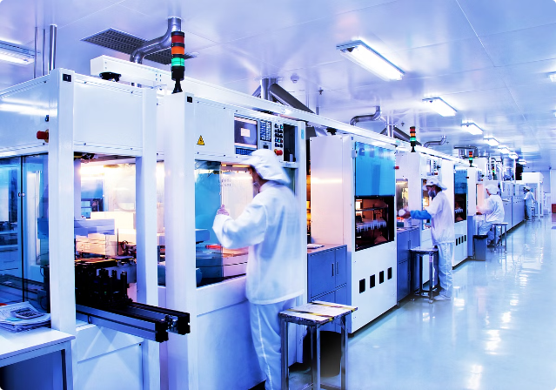
Robotics and Automation with Industry 4.0 by using Lean & TPM
Discover how industry is leveraging Industry 4.0 technologies, Lean methodologies, and TPM to drive innovation and efficiency in the 2-wheeler industry.

Slide 2

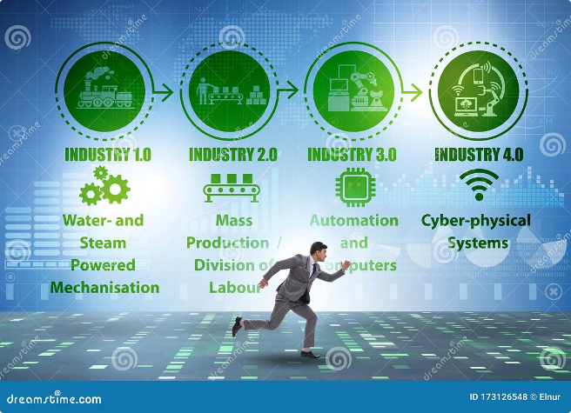
Understanding Industry 4.0
1
IoT (Internet of Things)
Connecting machines and systems for real-time data exchange
2
Big Data
Leveraging analytics to optimize processes and maintenance
3
AI (Artificial Intelligence)
Enabling autonomous decision-making and predictive capabilities
4
Cyber-Physical Systems
Integrating digital and physical components for enhanced control

Slide 3
Impact of Industry 4.0
Enhanced Connectivity
Automation
Data-Driven Decisions
Real-time communication between machines and systems
Autonomous systems and robotics for improved efficiency
Optimizing processes and maintenance through data analytics

Slide 4

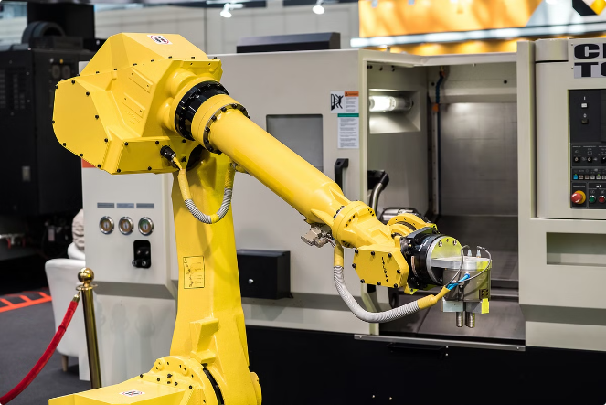
Robotics and Automation in 2-Wheeler Production
The 2-wheeler industry is increasingly leveraging advanced robotics and automation technologies to enhance productivity, quality, and safety across various manufacturing processes. Let's explore the different types of robots being used and their specific applications.
Collaborative Robots (Cobots)
Cobots are designed to work alongside human operators, assisting with tasks that require dexterity and precision. In 2-wheeler production, cobots are often used for component assembly, reducing the physical strain on workers and improving overall efficiency.
Industrial Robots
Industrial robots are highly-automated machines capable of performing repetitive tasks with speed and accuracy. In the 2-wheeler industry, industrial robots are commonly used for welding, painting, and material handling, ensuring consistent quality and reducing the risk of human errors.
Assembly Line Robots
Automated assembly line robots are instrumental in streamlining the production process for 2-wheelers. These robots handle tasks such as component placement, fastening, and quality inspection, enabling a seamless and efficient assembly workflow.
Welding and Painting Robots
Specialized robots equipped with welding and painting capabilities play a crucial role in the 2-wheeler manufacturing process. These robots deliver consistent results, reduce the risk of occupational hazards, and improve overall product quality.
In addition to the advanced robotics, 2-wheeler manufacturers are also embracing automation in various aspects of their production, such as CNC machining for precision parts, automated assembly lines, and data-driven quality control systems. This integrated approach to robotics and automation helps to drive innovation, enhance efficiency, and maintain the high standards expected in the 2-wheeler industry.

Slide 5

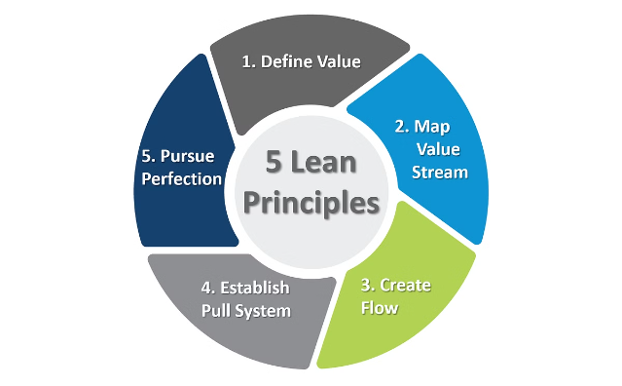
Lean Manufacturing at Hero MotoCorp
1
Value Stream Mapping
Identify and eliminate waste in processes
2
Continuous Improvement (Kaizen)
Foster a culture of incremental enhancements
3
Just-in-Time (JIT)
Optimize inventory and production flow

Slide 6


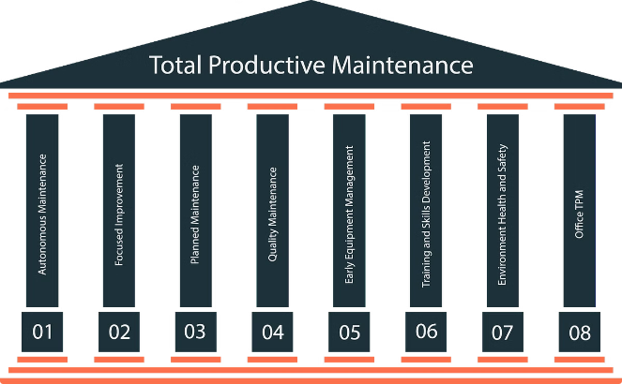



Total Productive Maintenance (TPM)
Equipment Effectiveness
Measure and improve OEE (Availability, Performance, Quality)
Autonomous Maintenance
Empower operators to maintain their own equipment
Quality Maintenance
Ensure consistent product quality through preventive measures
Focused Improvement
Continuously enhance equipment and processes

Slide 7




Integrating Industry 4.0 with Lean and TPM
The convergence of Industry 4.0 and lean manufacturing offers powerful synergies. By integrating these approaches, organizations can leverage IIoT, data analytics, and AI to enhance Lean and Total Productive Maintenance (TPM) practices.
Predictive Maintenance
Real-Time Process Optimization
Automated Quality Monitoring
IIoT sensors and analytics enable real-time equipment monitoring and predictive maintenance, reducing downtime and preserving production asset effectiveness.
Data-driven insights enable continuous waste elimination, process parameter optimization, and Lean improvement through Kaizen.
Computer vision and AI-powered quality inspection ensure consistent product quality and support TPM initiatives.

Slide 8
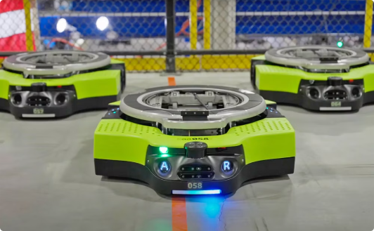

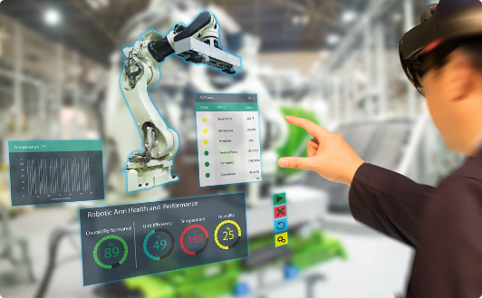
Future Trends and Opportunities
Advanced Robotics
Digital Twins
Augmented Reality
Increased use of collaborative and autonomous robots
Virtual models for real-time monitoring and optimization
Enhanced worker guidance and remote assistance

Slide 9
Key Subjects for Mechatronics
Mathematics
Manufacturing
Calculus
Linear Algebra
CNC Machining
Automation and Control Systems
Mechatronics System
Lean Manufacturing Principles
Design Integration of Mechanical and Electronic Systems
Industry 4.0
Mechatronics Design Process
Instrumentation
Project Management
Measurement Systems
Robotics
Signal Processing
Robot Kinematics and Dynamics
Software Tools
Robot Motion Planning
Robot Programming
CAD (SolidWorks, AutoCAD)
Automation Systems
Simulation (MATLAB, Simulink)
Soft Skills
Electronics
Analog Electronics
Technical Writing
Digital Electronics
Teamwork
Embedded Systems

Slide 10
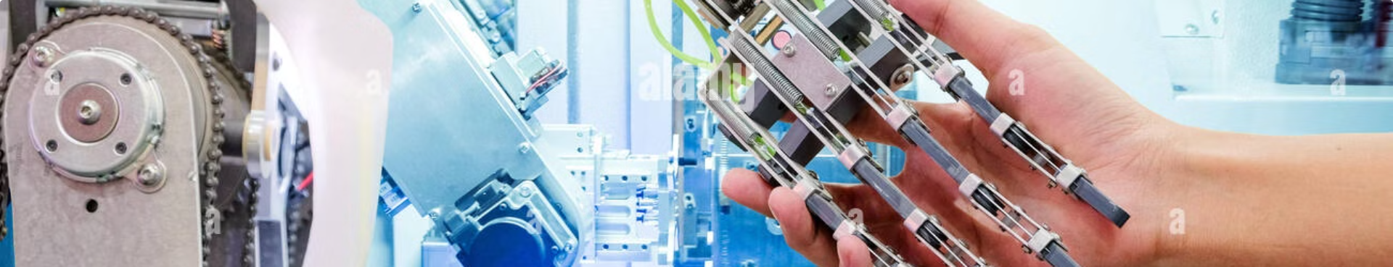
Conclusion
In conclusion, Hero MotoCorp's journey demonstrates the power of integrating Industry 4.0, Lean, and TPM to drive innovation and operational excellence in the 2-wheeler industry. Key takeaways include the importance of embracing automation, fostering a culture of continuous improvement, and leveraging data-driven insights to optimize processes and maintain high product quality.
By staying at the forefront of technological advancements, organizations can unlock new opportunities for enhanced efficiency, agility, and competitiveness. We thank you all for your attention and participation today. If you have any further questions or would like to discuss how to implement these strategies in your own business, please feel free to reach out to us at contact@heromohtocorp.com.

Slide 11


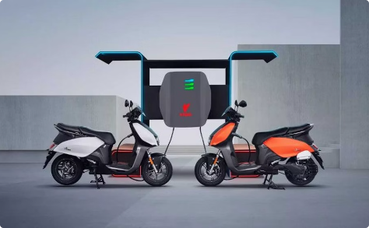
Ajith Srikanth
Ajith Srikanth
Hero MotoCorp
RA1811018010008 | ms1343@srmist.edu.in | ajithsri2000@gmail.com | +919833193027
Sy No.1, Industrial Park, Satyavedu Chevri Road, Satyavedu Mandal, Madanapalem, Tirupati, Andhra Pradesh - 517588

